Slide 1


Slide 2
Getting Started with Azure and Machine Learning
Subtitle or speaker name

Slide 3




Jasleen Sondhi
Speakers for Today-
Rahul Bordoloi
Alpha Student Ambassador
Alpha Student Ambassador
jasleen-sondhi rahulbordoloi
jasleen101010 rahulbordoloi

Slide 4
Agenda of The Session
Basics of Cloud Computing.
Fundamentals of Microsoft Azure.
Introduction to Machine Learning.
Getting started with Azure ML.

Slide 5


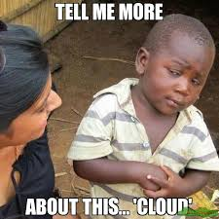
What is Cloud?
Cloud computing allows businesses to run essential programs and applications through the Internet, saving them time, space, hassle and lots and lots of money.
Billing for cloud services works just like the way you pay for utilities like gas and electricity in your home; it's pay-as-you-go.

Slide 6
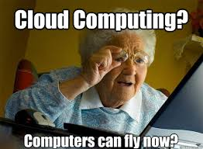
Benefits of Cloud Computing
Its cost-effective(Consumption Based Model)
It's scalable
It’s elastic
It's current
It’s reliable and secure
It’s global

Slide 7
3 Cornerstones of Cloud
Software as a Service-Software as a service, is a way of delivering centrally hosted applications over the internet as a service.
Infrastructure as a Service-Infrastructure as a service, IaaS or IaaS, allows customers to instantly build out new hardware and other network devices.
Platform as a Service-Platform as a Service or PaaS is relatively new to the cloud world but it has quickly gained customers as it provides an easier approach to accessing a development rich environment for application building.

Slide 8
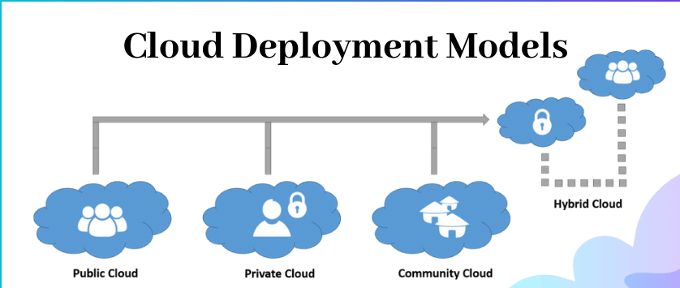

Slide 9
Cloud Deployment Models
A cloud deployment model basically defines how the data is stored and how users interact with it.
There are primarily 4 types of models-
Public-Public Cloud is a type of cloud hosting that allows the accessibility of systems & its services to its clients/users easily.
Private-As opposed to a public cloud that is available to the general public, only one specific company owns a private one.

Slide 10
Cloud Deployment Models
Community-A community deployment model largely resembles a private one; the only difference is the set of users.
Hybrid-Hybrid Cloud is another cloud computing type, which is integrated, i.e., it can be a combination of two or more cloud servers, i.e., private, public or community combined as one architecture, but remain individual entities.

Slide 11
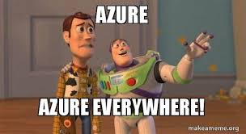
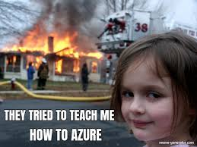

What is Microsoft Azure?

Slide 12
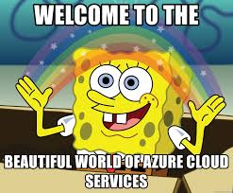
Microsoft Azure
The Microsoft Cloud is very, very large. It is connected by enough fiber to stretch to the Moon and back 3 times! That means the Microsoft Cloud is made up of millions of servers and everything is monitored 24x7x365.
Did you know that more than 90% of Fortune 500 companies run on the Microsoft Cloud?
Azure is Microsoft’s very own cloud computing platform. It offers the freedom to build, manage, and deploy applications on a massive, global network using your favorite tools and frameworks.

Slide 13
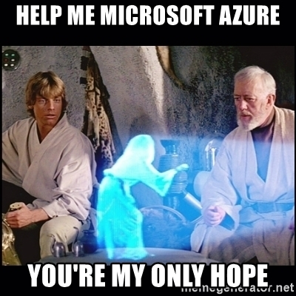
How does Azure work?
https://www.microsoft.com/en-us/videoplayer/embed/RWlzQ6?pid=RWlzQ6-ax-85-id-oneplayer&postJsllMsg=true&autoplay=false&mute=false&loop=false&market=en-us&playFullScreen=false

Slide 14
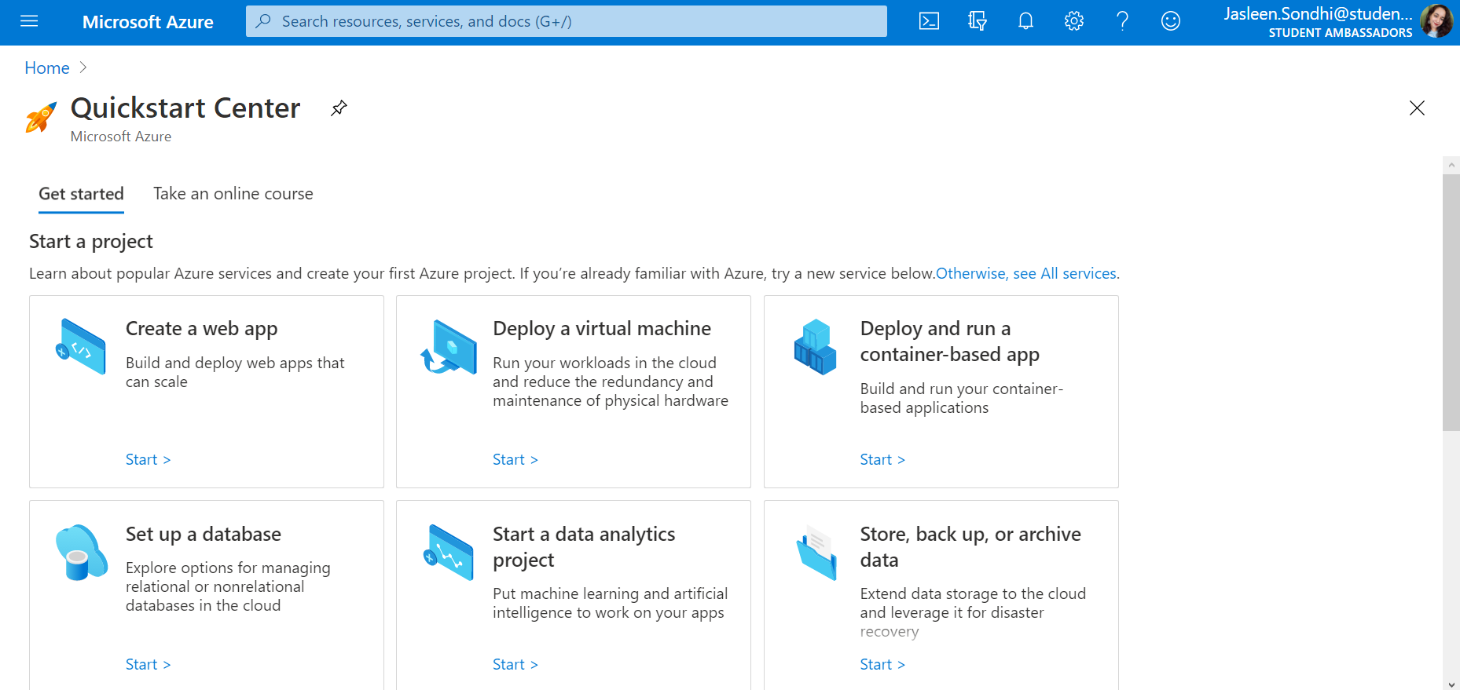
How to use Azure?
Step 1- Sign up for an account on www.azure.com
Step 2-Choose the subscription pack that suits your needs or create a free account if you are just starting out.

Slide 15
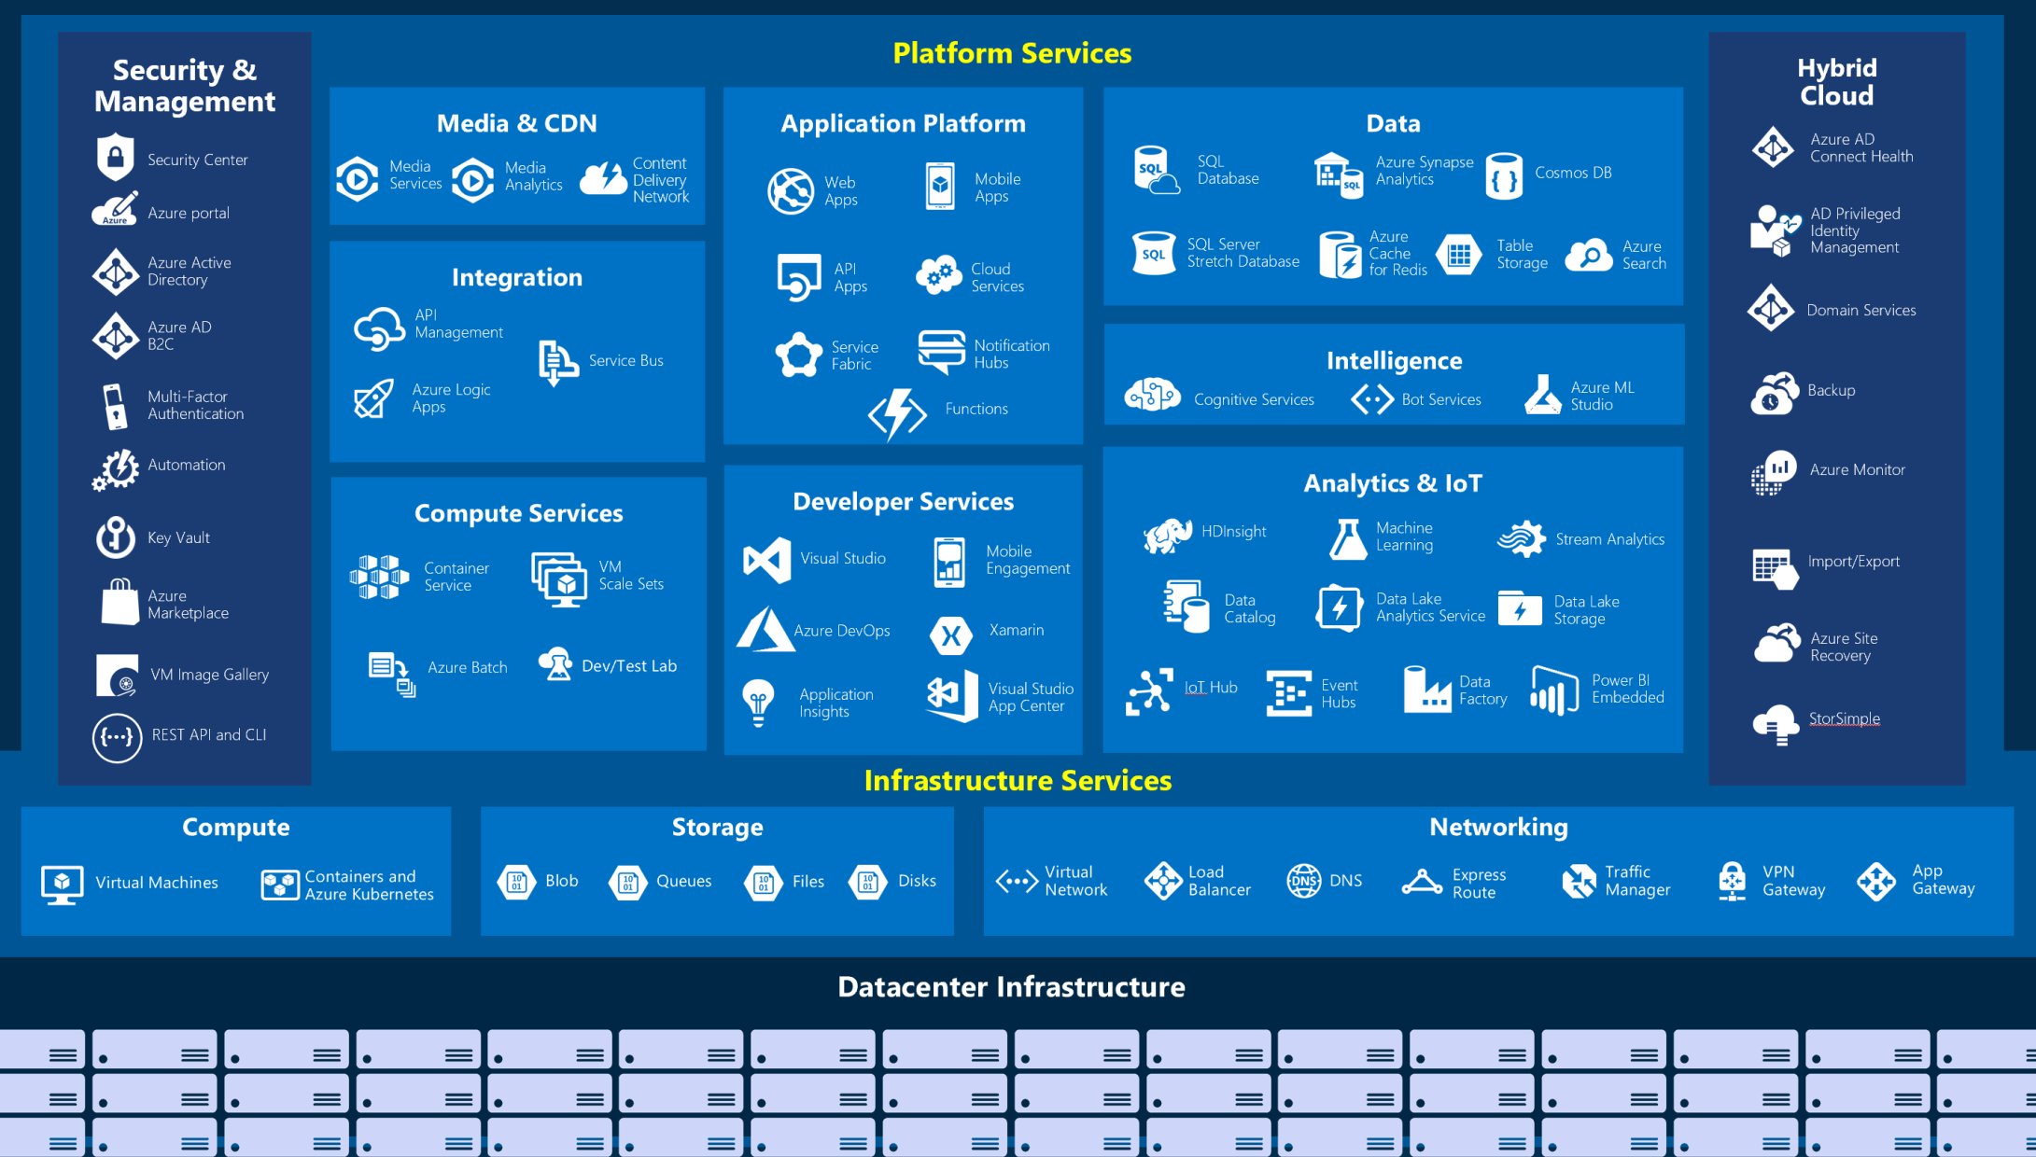
Tour of Azure Services

Slide 16
What is a VM? Why use a VM?
In computing, a virtual machine is an emulation of a computer system. Virtual machines are based on computer architectures and provide functionality of a physical computer. Their implementations may involve specialized hardware, software, or a combination.
There are many reasons why your company might consider using virtual machines. VMs allow for reduced overhead, with multiple systems operating from the same console at the same time. VMs also provide a safety net for your data, as they can be used to enable rapid disaster recovery and automatic backups.
Each VM has its own hardware including CPUs, memory, hard drives, network interfaces etc.

Slide 17
Lets learn how to create a VM!

Slide 18
Lets also learn how to deploy a web app on Azure!

Slide 19
Introduction to Machine Learning!

Slide 20
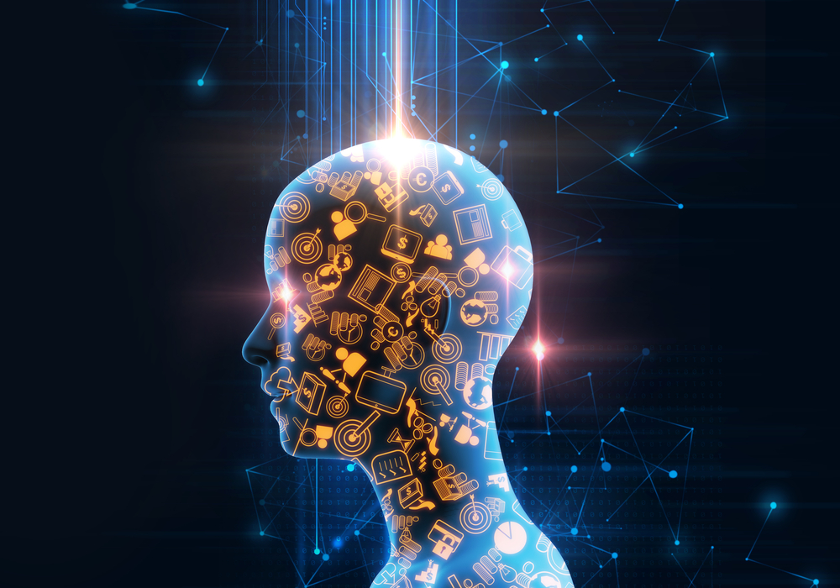
AI : Artificial Intelligence
How would you define Intelligence?

Slide 21
AI : Artificial Intelligence
How would you define Intelligence?
We're intelligent because wwe have the capability to learn and solve problems.
So,
INTELLIGENCE is the ability to learn and solve new problems.
AI - It's just a way to give machines the 'Intelligence'.

Slide 22

AI vs ML vs DL

Slide 23
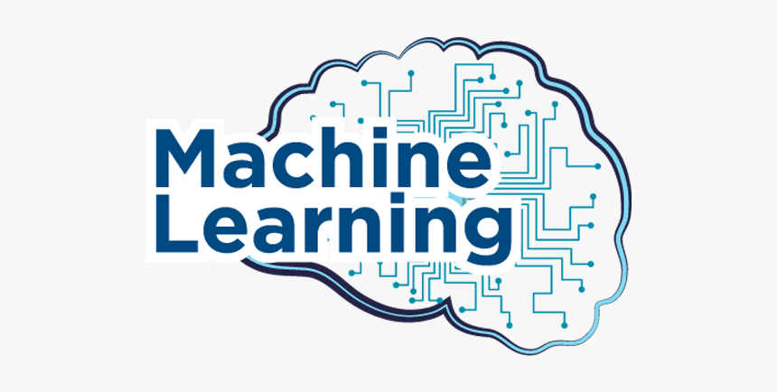

Slide 24
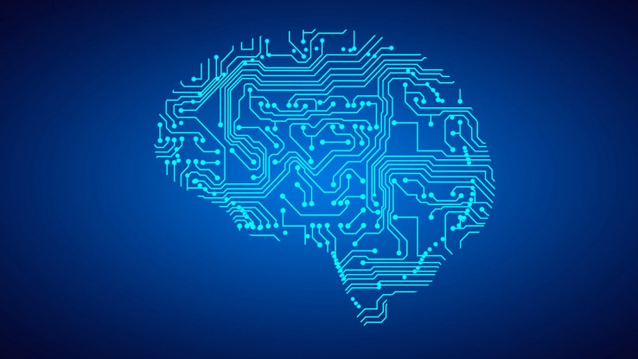
Machine Learning
Machine Learning is the field of study that gives computers ability to learn without being explicitly programmed.
Machine Learning is an application of Artificial Intelligence (AI).
The primary aim of ML is to allow the computers to learn automatically without human intervention or assistance and adjust actions accordingly.

Slide 25

That's what Real World Data Looks like - UNARRANGED

Slide 26
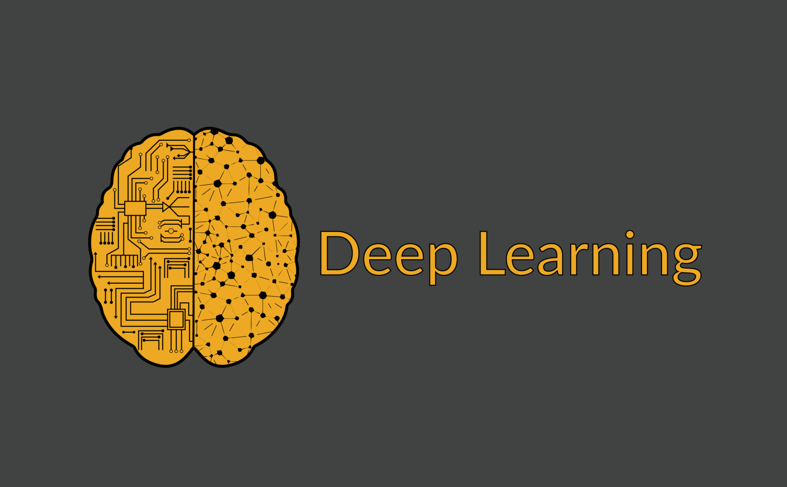
Best way to make Machine Intelligent is by learning from examples!
!setting the fixed rules.

Slide 27
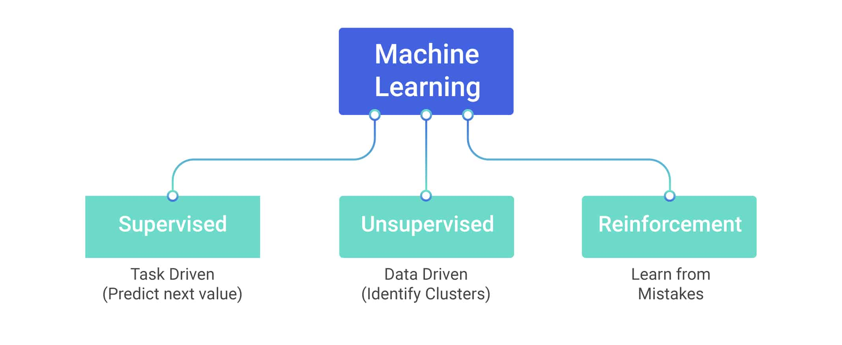
Types of ML Algorithms

Slide 28

Paradigms of Supervised Learning
Regression – Prediction result is a continuous real value. Eg - Real Estate price, Air Temperature etc.
Classification – Prediction result is a categorical value, yes or no, male or female etc.

Slide 29

Some Applications of Supervised Learning
Spam Detection.
Predicting if a comment in social media is hate speech or not.
Forecasting (Predicting) whether from previous trend.
BioInformatics.
Financial Trend Prediction.
Predicting COVID-19 infection from X-Ray images, and much more..

Slide 30
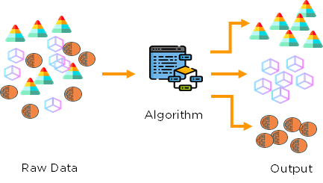
Unsupervised Learning : Clustering

Slide 31
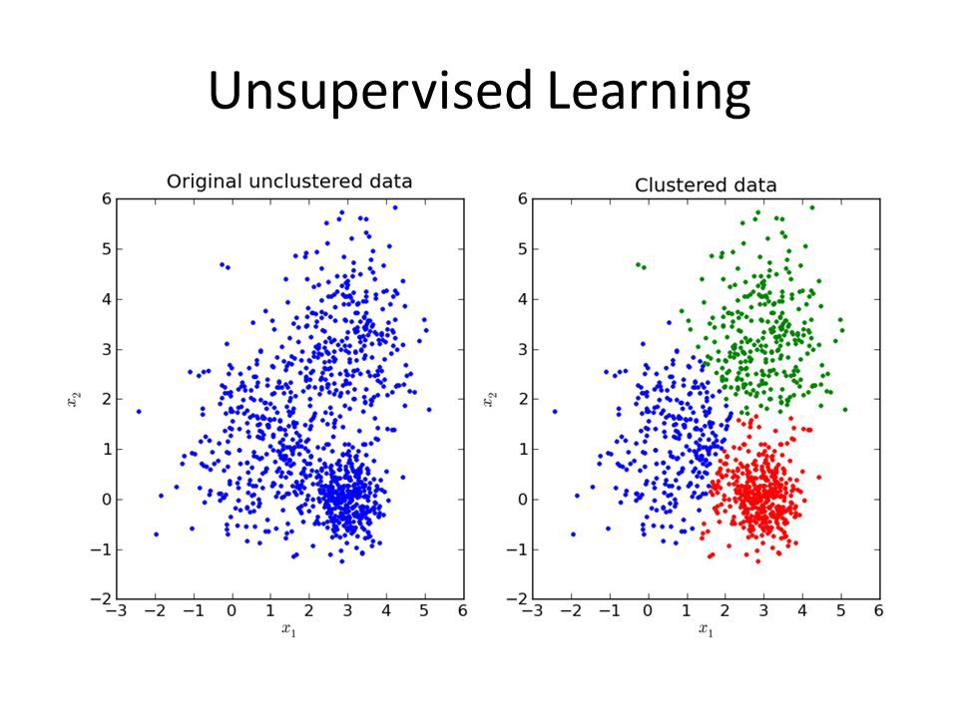
Some Applications of Unsupervised Learning
Customer Segmentation.
Image Segmentation.
Grouping same genes.
Anomaly Detections.
Recommender Systems, and many more...

Slide 32
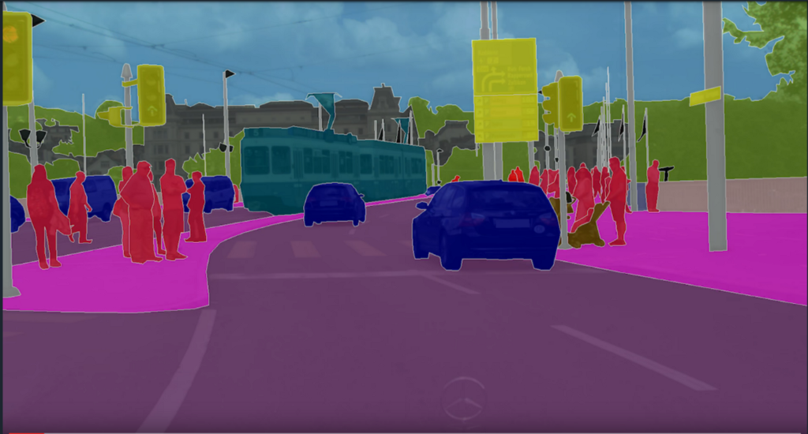
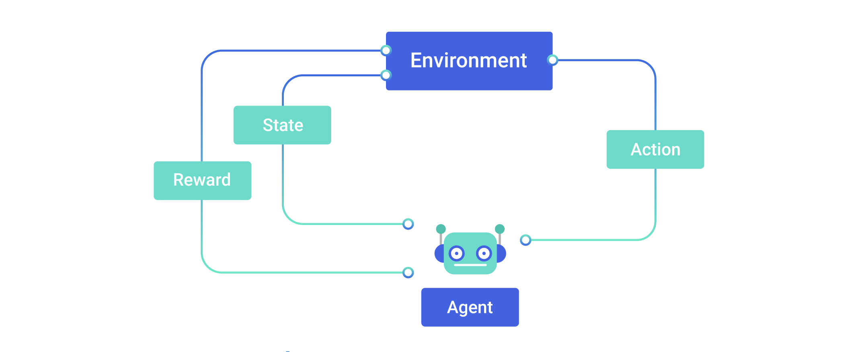
Reinforcement Learning

Slide 33

Some Applications of Reinforcement Learning
Self Driving Cars (eg - Tesla)
Robotics.
Health Care (Finding potential drugs for cure).
Trade Execution (JPMorgan)
Text Mining (Salesforce)
Game Playing (eg - DeepMind)
and many more...

Slide 34
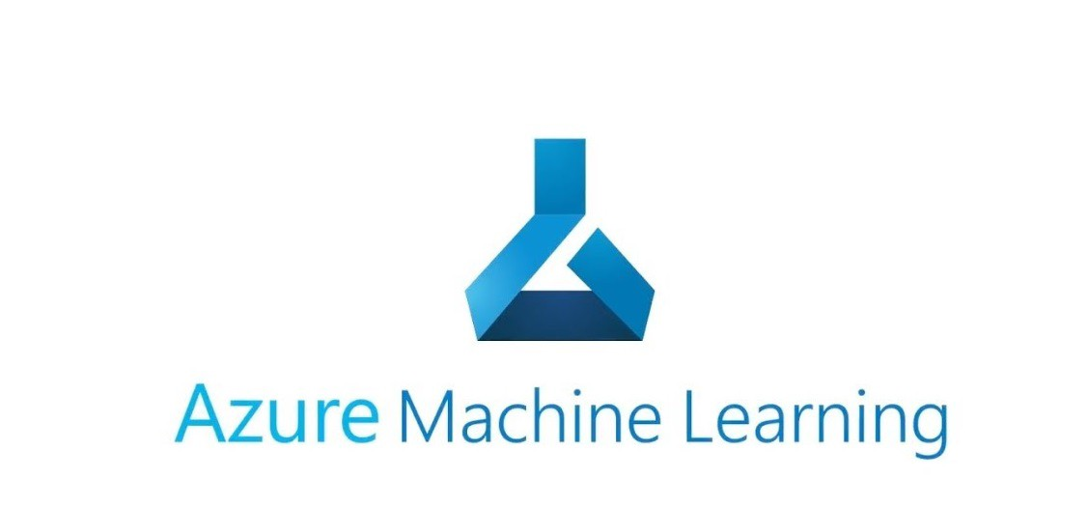
Knowing more about Azure ML

Slide 35
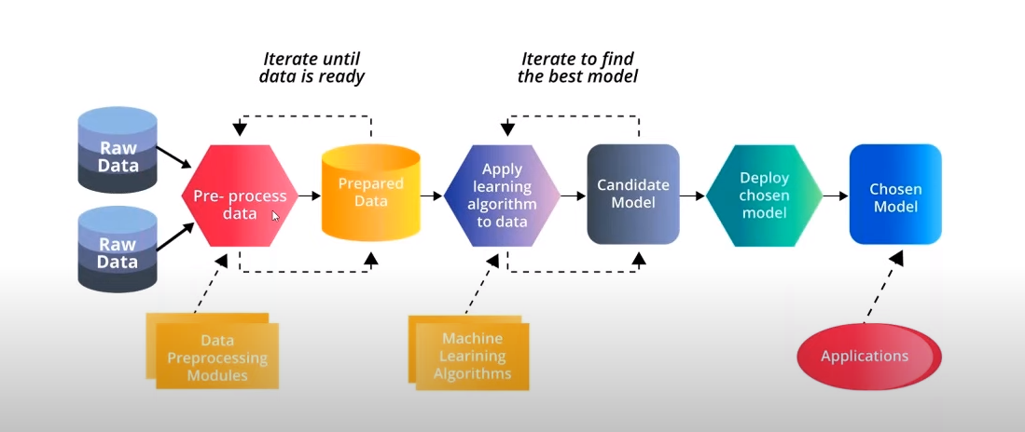
End to End ML Workflow

Slide 36
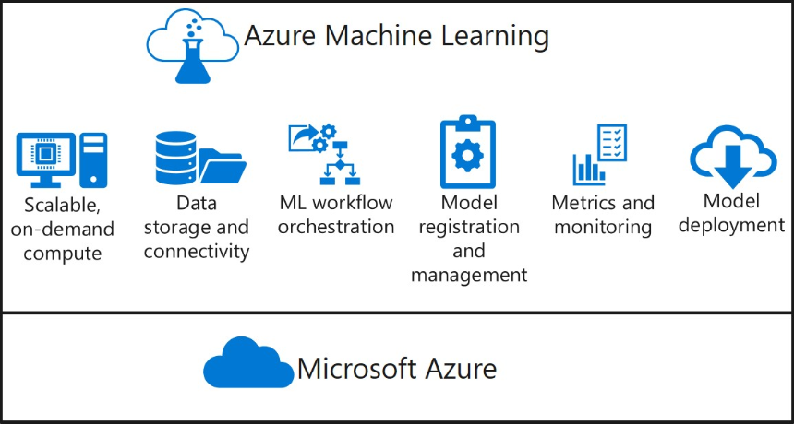
Azure Machine Learning
For more information refer : Build AI Solutions with Azure

Slide 37
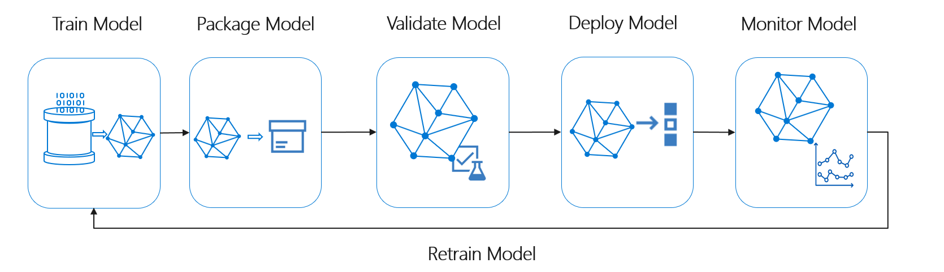
Azure Machine Learning

Slide 38
Getting Started with Azure ML!
Knowledge on Python or R.
a. Python for Beginners (Microsoft Developer)
Machine Learning Basics.
a. Andrew Ng (Machine Learning - Standford)
Azure Machine Learning (End to End)
a. Azure Machine Learning - https://azure.microsoft.com/en-us/services/machine-learning/
b. Azure ML Studio - https://studio.azureml.net/
Extra Tips -
Kaggle for better widening of knowledge.
a. Follow profiles of Kaggle Grandmaster Like - Abhishek Thakur, Parul Pandey, etc etc.
Microsoft AI School - https://aischool.microsoft.com/

Slide 39
Thank you!

